Slide 1
Pew Health Attitudes Analysis
Ryan Mayers

Slide 2
Overview
Using 2015 & 2016 Pew Global Attitudes Survey
Interested in health care perceptions
Intersection with economic, climate concerns

Slide 3
Limitations of Data Set
Questions are not asked of all countries
Questions and countries not identical year-to-year
Kenya, Nigeria, South Africa used
Limited number of potential subjects to examine
Some questions (one selected) change wording
Low numbers prevent rigorous statistics
Looking for preliminary trends
R-value correlations, but confidence values inappropriate

Slide 4
Analysis
9 questions (7 from each year)
Health care as a major national problem
Health care as most urgent priority
Optimism health care will improve (2016)
Personal issues affording health care in past year (2016)
View of current economic situation
Optimism about economy
Concern over global economic instability
Perception climate change is a current problem (2015)
Expectation of being personally affected by climate change (2015)

Slide 5
Analysis (cont.)
All questions measured as % of population
Also examining change between 2015-2016 perceptions
Searching for correlations between:
Health care perceptions and economic or climate perceptions
Current healthcare perceptions and personal impact or optimism
Trends of above between 2015 and 2016

Slide 6
Approach - Overview
Planned out in pseudo-code/outlines first
Using Pandas (for DataFrames) and MatPlotLib (for plots)
Examining if NumPy/any statistical work makes sense
Data entered manually
Datasets too large/too many irrelevant questions/countries for import
More familiarity, control over DataFrames & labels/variables/etc
Final Product: Charts, R-Values, and commentary for each result

Slide 7
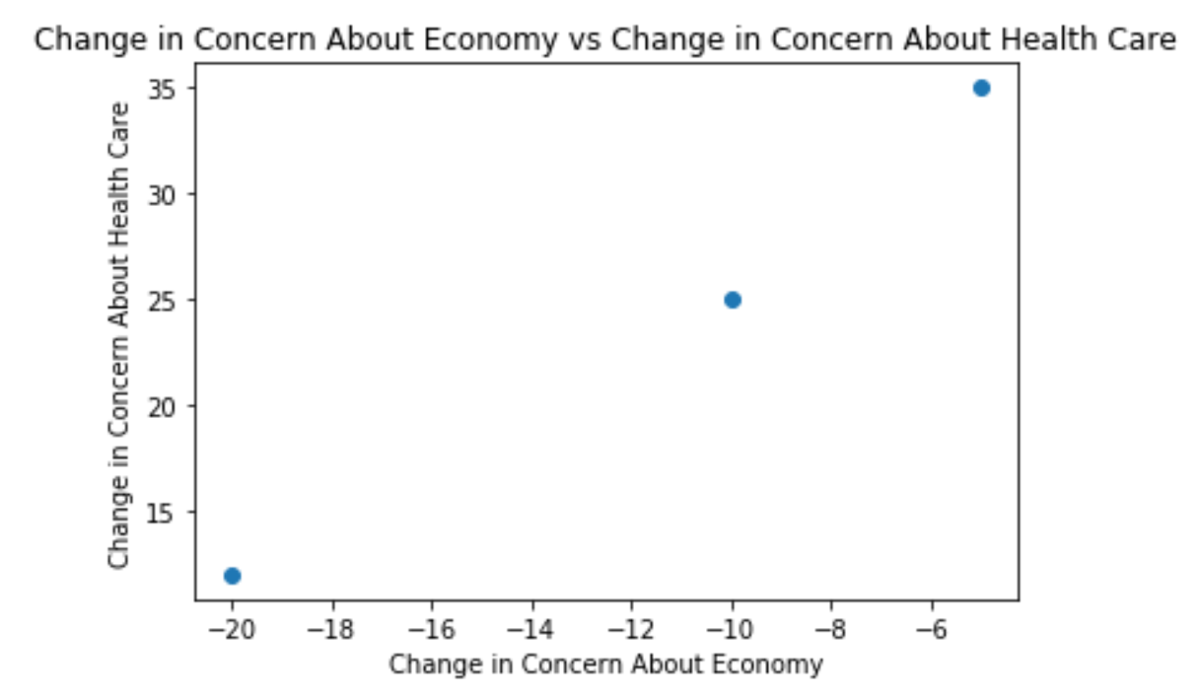
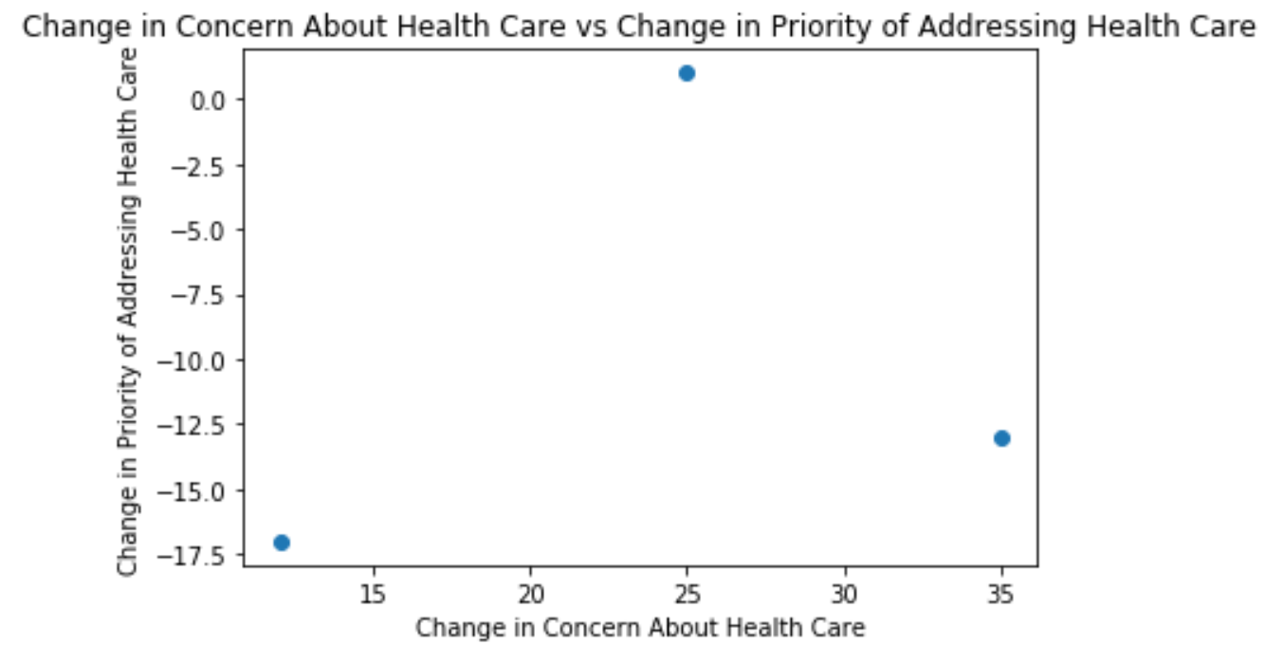
Factors to Consider
Improve familiarity with NumPy/Formatting
Regressions?
Consider increasing number of surveys used (= more samples)
Add user input controls to allow better presentation of results?

